Slide 1
SECURE DATA HIDING IN IMAGE USING Steganography
CAPSTONE PROJECT
Presented By: Priyanshu Naiya
College Name: MIT ADT University, Pune
Department: TY CSE

Slide 2
OUTLINE
Problem Statement
Technology used
Wow factor
End users
Result
Conclusion
Git-hub Link
Future scope

Slide 3
Problem Statement
In today’s digital age, ensuring the confidentiality of sensitive information is crucial. Traditional encryption methods are effective but can draw attention. This project provides a secure image steganography solution to hide secret messages within images, offering an extra layer of privacy while maintaining the original image appearance. It enables covert communication without raising suspicion, making it ideal for secure data sharing across untrusted channels.

Slide 4
Technology used
Frontend:
HTML, CSS: Customizes the cyberpunk-themed UI with neon-yellow highlights, futuristic fonts, and interactive styling.
Backend:
Python: Core programming language used to develop the steganography portal and handle image encryption and decryption processes.
OpenCV/NumPy: Handles images processing and image array manipulation for encoding and decoding.
Hosting & Storage:
Streamlit Cloud: Deployed using Streamlit Community Cloud for easy public access and scalability.
In-Memory (Tempfile): Stores uploaded and processed images temporarily without permanent storage.
Platforms:
Web-based (Accessible via browser)
Works on Desktop & Mobile

Slide 5
Wow factors
Secure Image Steganography
Conceals sensitive messages within images while preserving their original appearance, ensuring discreet communication.
Password-Protected Access
Enhances security by requiring a password for both embedding and retrieving hidden messages.
Efficient and Fast Processing
Provides real-time encryption, decryption, and image previews with minimal processing time.
User-Friendly Interface
Offers an intuitive, cyberpunk-themed interface for seamless message encryption and decryption.
Global Accessibility
Deployed on Streamlit Community Cloud, enabling secure access and sharing from any device, anywhere.

Slide 6
End users
Cybersecurity Enthusiasts:
Individuals interested in data privacy and secure communication.
Journalists & Whistleblowers:
Professionals who need to share sensitive information discreetly.
Researchers & Academics:
Those studying steganography, cryptography, or secure data transmission.
Law Enforcement & Intelligence Agencies:
Organizations that use steganography for secure messaging and investigations.
General Users & Privacy-Conscious Individuals:
Anyone looking to hide personal data or confidential messages within images

Slide 7
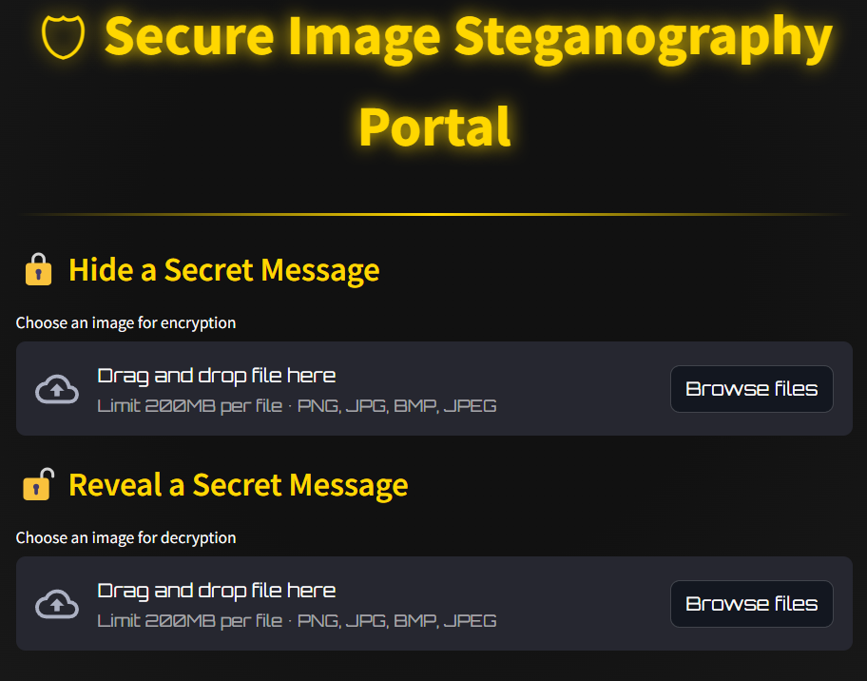
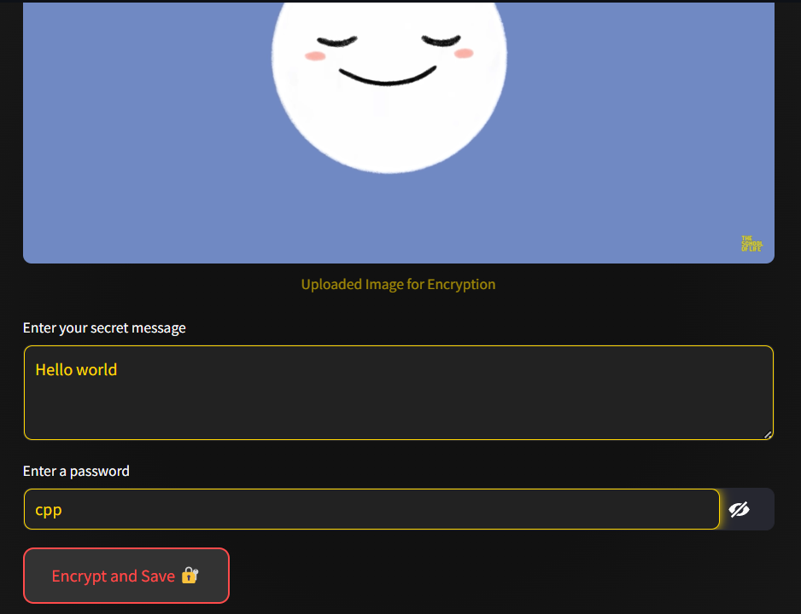
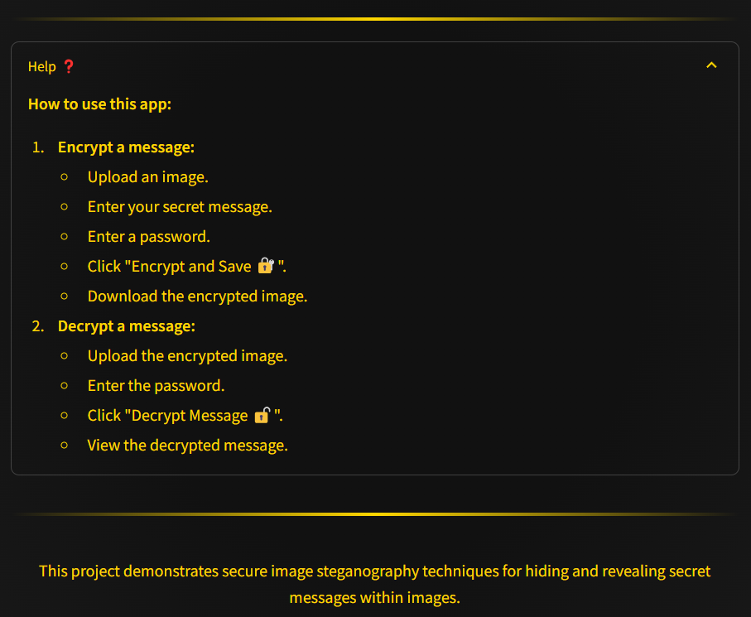
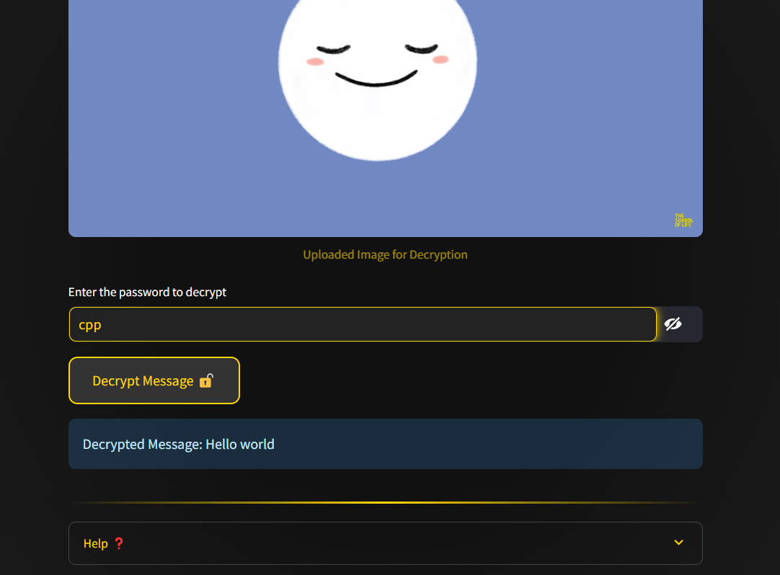
Results
1.
2.
4.
3.

Slide 8
Conclusion
The Secure Image Steganography Portal offers a reliable and user-friendly solution for hiding and extracting sensitive information within images. By combining advanced image processing with password protection, the application ensures confidential and secure communication. Its intuitive interface and efficient performance make it accessible to both technical and non-technical users.
The platform can be easily adapted for various security applications, including private messaging, data protection, and secure information sharing. This project demonstrates the practical application of steganography in modern digital communication while maintaining a balance between usability and security.

Slide 9
GitHub Link
https://github.com/naiyapriyanshu/Steganography-tool.git

Slide 10
Future scope(optional)
Advanced Encryption Techniques
Implement AES or RSA encryption to further secure hidden messages before embedding them in images.
Support for Multiple File Types
Extend steganography beyond images to include audio and video files for enhanced versatility.
AI-Based Steganography
Use machine learning to optimize data hiding, making detection even more difficult.
Mobile App Integration
Develop a mobile application for on-the-go steganography, making it more accessible to users.
Cloud Storage & Secure Sharing
Enable users to store and share stego-images securely using cloud integration.
Multi-Layered Steganography
Implement techniques that allow multiple messages to be hidden in a single image using different encoding methods.

Slide 11
THANK YOU

